Slide 1
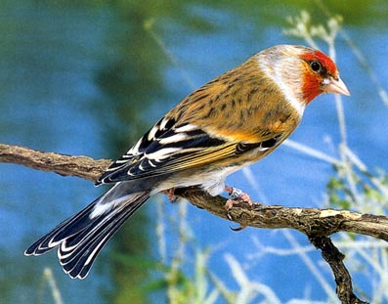
Hybridization in Birds:
A Worldwide Survey
Gene McCarthy
Genetics Department
University of Georgia

Slide 2
This presentation summarizes data about bird hybrids from my recently published book (Handbook of Avian Hybrids, Oxford University Press, 2006)

Slide 3
Handbook is a worldwide survey
- All crosses ever reported

Slide 4
Handbook is a worldwide survey
- All crosses ever reported
- Captive and natural

Slide 5
Handbook is a worldwide survey
- All crosses ever reported
- Captive and natural
- Most comprehensive study to date

Slide 6
Handbook is a worldwide survey
- All crosses ever reported
- Captive and natural
- Most comprehensive study to date
- More than 5,300 works cited

Slide 7
We’ll be discussing:
- Rates of hybridization

Slide 8
We’ll be discussing:
- Rates of hybridization
- Fertility of hybrids

Slide 9
We’ll be discussing:
- Rates of hybridization
- Fertility of hybrids
- Global geography of hybridization

Slide 10
Captive Hybridization

Slide 11
The handbook lists 1460 different crosses that have occurred in captivity.

Slide 12
Example of a hybrid produced in captivity:
European Goldfinch (Carduelis carduelis)
x Canary (Serinus canarius)

Slide 13
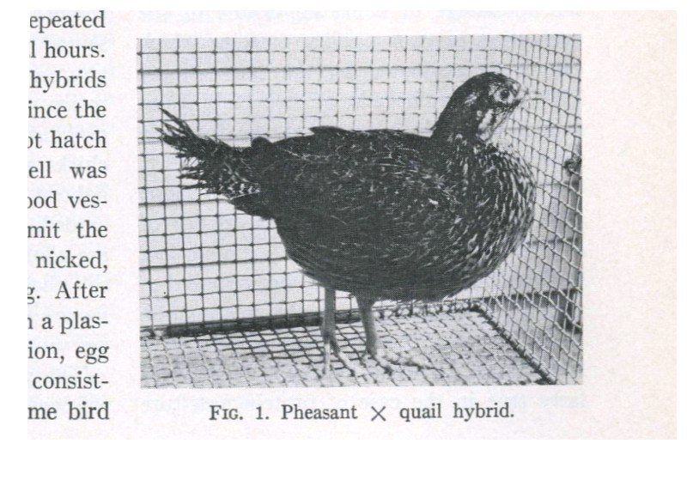
Another example:
(Phasianus colchicus x Coturnix japonica)

Slide 14
Natural hybridization

Slide 15
Abbreviation Key
NHR: Natural Hybridization Reported

Slide 16
Abbreviation Key
NHR: Natural Hybridization Reported

Slide 17
Abbreviation Key
NHR: Natural Hybridization Reported
ONHR: Ongoing Natural Hybridization Reported

Slide 18
Abbreviation Key
NHR: Natural Hybridization Reported
ONHR: Ongoing Natural Hybridization Reported

Slide 19
Abbreviation Key
NHR: Natural Hybridization Reported
ONHR: Ongoing Natural Hybridization Reported
ENHR: Extensive Natural Hybridization Reported

Slide 20
Abbreviation Key
NHR: Natural Hybridization Reported
ONHR: Ongoing Natural Hybridization Reported
ENHR: Extensive Natural Hybridization Reported

Slide 21
NHR means…
Either:
A cross occurs rarely

Slide 22
NHR means…
Either:
A cross occurs rarely
or
It has been reported rarely, perhaps due to a lack of study.

Slide 23
NHR means…
Either:
A cross occurs rarely
or
It has been reported rarely, perhaps due to a lack of study.
(These two cases are often hard to distinguish)

Slide 24
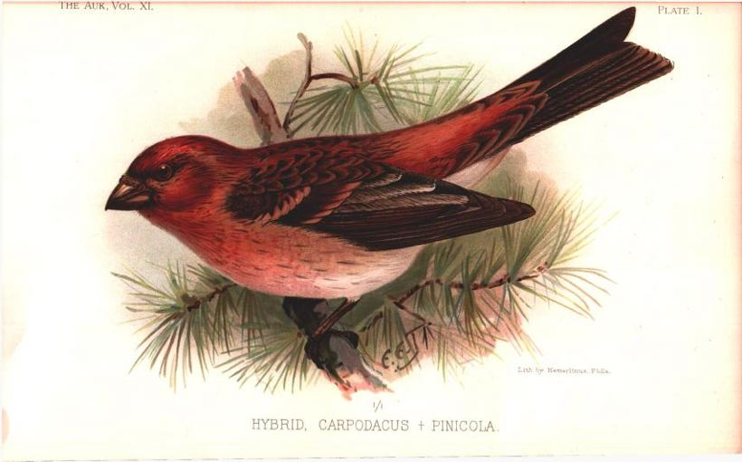
Rates of Natural Hybridization
 | Nonpasserines | Passerines
NHR | 497(116) | 331(32)
    Purple Finch (Carpodacus purpureus) x Pine Grosbeak (Pinicola enucleator)

Slide 25
ONHR means…
Either:
Multiple reports of cross occurring in natural setting

Slide 26
ONHR means…
Either:
Multiple reports of cross occurring in natural setting
or
At least one report indicates natural hybrids occur on an ongoing basis (at relatively low levels).

Slide 27
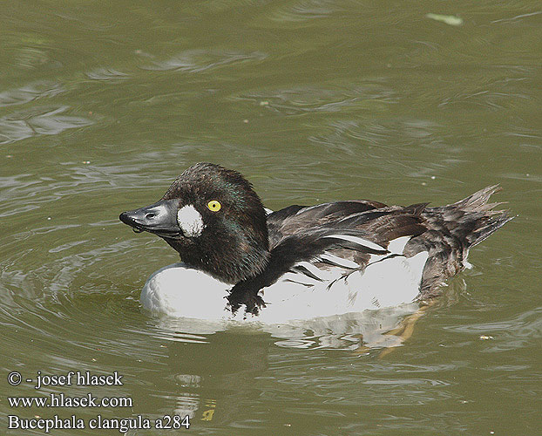
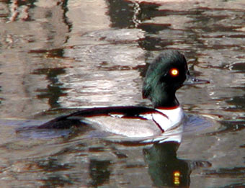
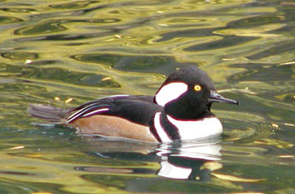
Goldeneye (Bucephala clangula)
Hybrid
Hooded Merganser (Bucephala clangula)

Slide 28
ENHR means…
Either:
Many reports of cross occurring in natural setting

Slide 29
ENHR means…
Either:
Many reports of cross occurring in natural setting
or
At least one report indicates many natural hybrids occur on an ongoing basis.

Slide 30
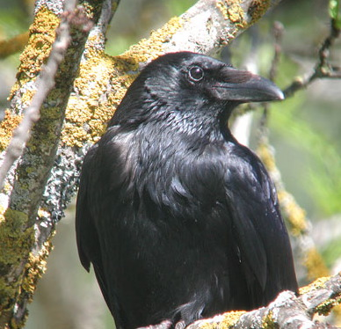
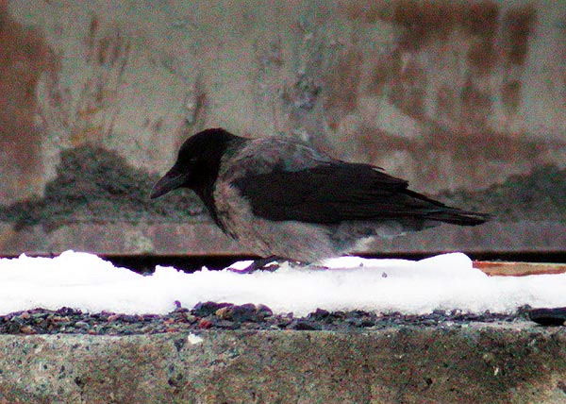
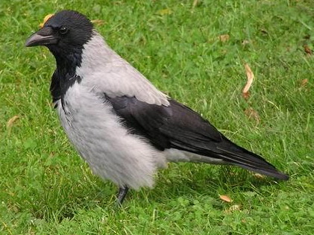
An example of extensive hybridization
Carrion Crow (Corvus corone)
HYBRID
Hooded Crow (Corvus cornix)

Slide 31
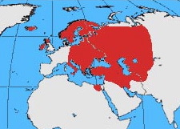
Hooded
Two widely separated hybrid zones

Slide 32
Hooded
Carrion
Two widely separated hybrid zones

Slide 33
Hooded
Carrion
Carrion
Two widely separated hybrid zones

Slide 34
Hooded
Carrion
Carrion
Two widely separated hybrid zones

Slide 35
Hooded
Carrion
Carrion
Two widely separated hybrid zones

Slide 36
Rates of Natural Hybridization
NUMBER OF CROSSES
1711 TYPES OF AVIAN CROSSES

Slide 37
Totals (3171 Avian Crosses):

Slide 38
Totals do not include:
-Suspected hybrid specimens of unknown parentage

Slide 39
Totals do not include:
-Suspected hybrid specimens of unknown parentage
-Cases of mixed nesting/copulation/courting (unless a hybrid was also reported)

Slide 40
Totals do not include:
-Suspected hybrid specimens of unknown parentage
-Cases of mixed nesting/copulation/courting (unless a hybrid was also reported)
-Interbreeding between populations which have always been treated as races of the same bird

Slide 41
Fertility and Sterility

Slide 42
Fertility and Sterility
(3172 different types of crosses)
The term partially fertile means that the hybrids in question have produced offspring, but that the typical hybrid is less fertile than its parents.

Slide 43
Probable reporting bias: Sterility is harder to document than fertility, so it is probably overreported.

Slide 44
Avian crosses producing partially fertile hybrids are far more common (~8x) than crosses known to produce sterile hybrids.

Slide 45
Fertility and Sterility

Slide 46
Fertility and Sterility
Continuum of cases

Slide 47
Haldane’s Rule
Among 497 crosses yielding partially fertile hybrids:
- 84 crosses: only males are fertile.

Slide 48
Haldane’s Rule
Among 497 crosses yielding partially fertile hybrids:
- 84 crosses: only males are fertile.

Slide 49
Haldane’s Rule
Some crosses only produce male hybrids.

Slide 50
Haldane’s Rule
Some crosses only produce male hybrids.
None produce only female hybrids.

Slide 51
Haldane’s Rule
Some crosses only produce male hybrids.
None produce only female hybrids.
In many avian crosses the sex ratio is biased toward males.

Slide 52
Geographic distribution

Slide 53
Rates of Natural Hybridization
NUMBER OF CROSSES
1711 TYPES OF AVIAN CROSSES

Slide 54
Rates of Natural Hybridization
NUMBER OF CROSSES
1711 TYPES OF AVIAN CROSSES

Slide 55
Rates of Natural Hybridization
NUMBER OF CROSSES
1711 TYPES OF AVIAN CROSSES

Slide 56
A map showing the locations of avian hybrid zones, worldwide…
NUMBER OF CROSSES

Slide 57
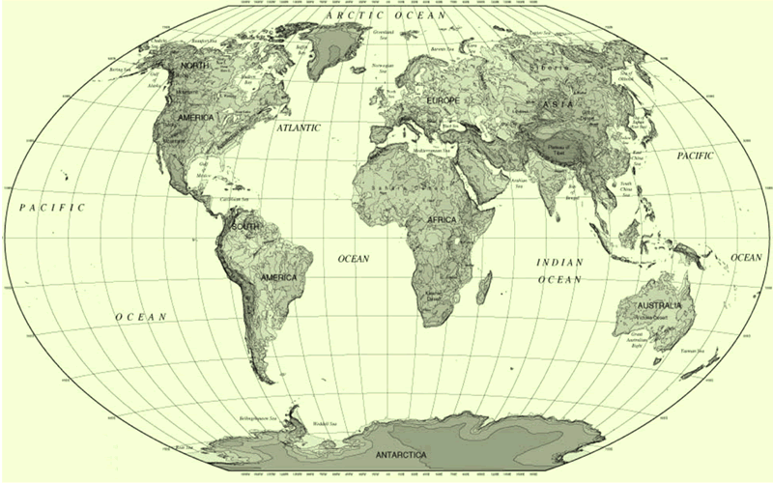

Slide 92
Thanks!

Slide 94
Acknowledgements:
Paul Mack, Univ. of Georgia
Tim Melling, British Ornithologist’s Union
Jemima Parry-Jones, National Birds of Prey Centre, UK
J. P. Schmidt, Univ. of Georgia
Lucia Severinghaus, Academica Sinica, Taipei
Daniel Shearing, Foreign Bird League
Michael Sorenson, Boston Univ.
Per Thingstad, Museum of Natural History and Archeology, Trondheim
William Todd, Houston Zoo
Ülo Väli, Estonian Agricultural Univ.
Renate van den Elzen, Alexander Koenig Museum
Vince Walkosak, Arizona-Sonora Desert Museum
Carolyn Walsh, Memorial Univ. of Newfoundland
Bill Aragon, Albuquerque Biological Park
John Avise, Univ. of Georgia
Jonathan Barnaby, DEFRA, UK
Mark Bremer, National Aviary
Michael Brooks, SAFRING
Nick Fox, International Wildlife Consultants Ltd.
Anthony Ganesh, Singapore Zoo
Jim Granlund, Michigan Audubon Society
Diana Hartle, Univ. of Georgia
Holly Green, Indianapolis Zoo
Kai Grosch, Max Planck Institute
David Hancock, Hancock Wildlife Research Center
Laszlo Janossy, Budapest Zoo
Daisy Ling, Jurong Bird Park, Singapore

Slide 95
Acknowledgements:
Paul Mack, Univ. of Georgia
Tim Melling, British Ornithologist’s Union
Jemima Parry-Jones, National Birds of Prey Centre, UK
J. P. Schmidt, Univ. of Georgia
Lucia Severinghaus, Academica Sinica, Taipei
Daniel Shearing, Foreign Bird League
Michael Sorenson, Boston Univ.
Per Thingstad, Museum of Natural History and Archeology, Trondheim
William Todd, Houston Zoo
Ülo Väli, Estonian Agricultural Univ.
Renate van den Elzen, Alexander Koenig Museum
Vince Walkosak, Arizona-Sonora Desert Museum
Carolyn Walsh, Memorial Univ. of Newfoundland
Bill Aragon, Albuquerque Biological Park
John Avise, Univ. of Georgia
Jonathan Barnaby, DEFRA, UK
Mark Bremer, National Aviary
Michael Brooks, SAFRING
Nick Fox, International Wildlife Consultants Ltd.
Anthony Ganesh, Singapore Zoo
Jim Granlund, Michigan Audubon Society
Diana Hartle, Univ. of Georgia
Holly Green, Indianapolis Zoo
Kai Grosch, Max Planck Institute
David Hancock, Hancock Wildlife Research Center
Laszlo Janossy, Budapest Zoo
Daisy Ling, Jurong Bird Park, Singapore

Slide 96
Acknowledgements:
Paul Mack, Univ. of Georgia
Tim Melling, British Ornithologist’s Union
Jemima Parry-Jones, National Birds of Prey Centre, UK
J. P. Schmidt, Univ. of Georgia
Lucia Severinghaus, Academica Sinica, Taipei
Daniel Shearing, Foreign Bird League
Michael Sorenson, Boston Univ.
Per Thingstad, Museum of Natural History and Archeology, Trondheim
William Todd, Houston Zoo
Ülo Väli, Estonian Agricultural Univ.
Renate van den Elzen, Alexander Koenig Museum
Vince Walkosak, Arizona-Sonora Desert Museum
Carolyn Walsh, Memorial Univ. of Newfoundland
Bill Aragon, Albuquerque Biological Park
John Avise, Univ. of Georgia
Jonathan Barnaby, DEFRA, UK
Mark Bremer, National Aviary
Michael Brooks, SAFRING
Nick Fox, International Wildlife Consultants Ltd.
Anthony Ganesh, Singapore Zoo
Jim Granlund, Michigan Audubon Society
Diana Hartle, Univ. of Georgia
Holly Green, Indianapolis Zoo
Kai Grosch, Max Planck Institute
David Hancock, Hancock Wildlife Research Center
Laszlo Janossy, Budapest Zoo
Daisy Ling, Jurong Bird Park, Singapore

Slide 97
Acknowledgements:
Paul Mack, Univ. of Georgia
Tim Melling, British Ornithologist’s Union
Jemima Parry-Jones, National Birds of Prey Centre, UK
J. P. Schmidt, Univ. of Georgia
Lucia Severinghaus, Academica Sinica, Taipei
Daniel Shearing, Foreign Bird League
Michael Sorenson, Boston Univ.
Per Thingstad, Museum of Natural History and Archeology, Trondheim
William Todd, Houston Zoo
Ülo Väli, Estonian Agricultural Univ.
Renate van den Elzen, Alexander Koenig Museum
Vince Walkosak, Arizona-Sonora Desert Museum
Carolyn Walsh, Memorial Univ. of Newfoundland
Bill Aragon, Albuquerque Biological Park
John Avise, Univ. of Georgia
Jonathan Barnaby, DEFRA, UK
Mark Bremer, National Aviary
Michael Brooks, SAFRING
Nick Fox, International Wildlife Consultants Ltd.
Anthony Ganesh, Singapore Zoo
Jim Granlund, Michigan Audubon Society
Diana Hartle, Univ. of Georgia
Holly Green, Indianapolis Zoo
Kai Grosch, Max Planck Institute
David Hancock, Hancock Wildlife Research Center
Laszlo Janossy, Budapest Zoo
Daisy Ling, Jurong Bird Park, Singapore

Slide 98
Acknowledgements:
Paul Mack, Univ. of Georgia
Tim Melling, British Ornithologist’s Union
Jemima Parry-Jones, National Birds of Prey Centre, UK
J. P. Schmidt, Univ. of Georgia
Lucia Severinghaus, Academica Sinica, Taipei
Daniel Shearing, Foreign Bird League
Michael Sorenson, Boston Univ.
Per Thingstad, Museum of Natural History and Archeology, Trondheim
William Todd, Houston Zoo
Ülo Väli, Estonian Agricultural Univ.
Renate van den Elzen, Alexander Koenig Museum
Vince Walkosak, Arizona-Sonora Desert Museum
Carolyn Walsh, Memorial Univ. of Newfoundland
Bill Aragon, Albuquerque Biological Park
John Avise, Univ. of Georgia
Jonathan Barnaby, DEFRA, UK
Mark Bremer, National Aviary
Michael Brooks, SAFRING
Nick Fox, International Wildlife Consultants Ltd.
Anthony Ganesh, Singapore Zoo
Jim Granlund, Michigan Audubon Society
Diana Hartle, Univ. of Georgia
Holly Green, Indianapolis Zoo
Kai Grosch, Max Planck Institute
David Hancock, Hancock Wildlife Research Center
Laszlo Janossy, Budapest Zoo
Daisy Ling, Jurong Bird Park, Singapore

